Slide 1
Number System

Slide 2
Number Systems
A number system defines a set of values used to represent quantity.
It can be categorized in two broad categories:
Non – Positional Number Systems
Stones or sticks were used to indicate values
Difficult to perform arithmetic because it has no symbol for zero.
Example: Roman number systems – Few characters are used such as I, V, X, L (fifty), C (hundred)

Slide 3
Number System
2. Positional Number Systems
The value of each digit in number is defined not only by the symbol but also by symbol’s position.
Positional number systems have base or radix.

Slide 4
Common Number Systems
System | Base | Symbols | Used by humans? | Used in computers?
Decimal | 10 | 0, 1, … 9 | Yes | No
Binary | 2 | 0, 1 | No | Yes
Octal | 8 | 0, 1, … 7 | No | No
Hexa- decimal | 16 | 0, 1, … 9, A, B, … F | No | No

Slide 5
Quantities/Counting (1 of 3)
Decimal | Binary | Octal | Hexa- decimal
0 | 0 | 0 | 0
1 | 1 | 1 | 1
2 | 10 | 2 | 2
3 | 11 | 3 | 3
4 | 100 | 4 | 4
5 | 101 | 5 | 5
6 | 110 | 6 | 6
7 | 111 | 7 | 7

Slide 6
Quantities/Counting (2 of 3)
Decimal | Binary | Octal | Hexa- decimal
8 | 1000 | 10 | 8
9 | 1001 | 11 | 9
10 | 1010 | 12 | A
11 | 1011 | 13 | B
12 | 1100 | 14 | C
13 | 1101 | 15 | D
14 | 1110 | 16 | E
15 | 1111 | 17 | F

Slide 7
Quantities/Counting (3 of 3)
Decimal | Binary | Octal | Hexa- decimal
16 | 10000 | 20 | 10
17 | 10001 | 21 | 11
18 | 10010 | 22 | 12
19 | 10011 | 23 | 13
20 | 10100 | 24 | 14
21 | 10101 | 25 | 15
22 | 10110 | 26 | 16
23 | 10111 | 27 | 17
Etc.

Slide 8
Conversion Among Bases
The possibilities:
Decimal
Octal
Binary
Hexadecimal

Slide 9
Quick Example
25₁₀ = 11001₂ = 31₈ = 19₁₆
Base

Slide 10
Decimal to Decimal (just for fun)
Decimal
Octal
Binary
Hexadecimal

Slide 11
Weight
125₁₀ => 5 x 10⁰ = 5 2 x 10¹ = 20 1 x 10² = 100 125
Base

Slide 12
Decimal to Binary
Decimal
Octal
Binary
Hexadecimal

Slide 13
Decimal to Binary
Technique
Divide by two, keep track of the remainder
First remainder is bit 0 (LSB, least-significant bit)
Second remainder is bit 1
Etc.

Slide 14
Conversion of Decimal to Binary
1. Determine the Binary equivalent of (125)10
2 | 125 | Remainder
2 | 62 | 1
2 | 31 | 0
2 | 15 | 1
2 | 7 | 1
2 | 3 | 1
2 | 1 | 1
 | 0 | 1
Least Significant Bit ( LSB)
Most Significant Bit ( MSB)
125₁₀ = 1111101₂

Slide 15
Conversion of Decimal to Binary
2. Determine the Binary equivalent of (36)10
2 | 36 | Remainder
2 | 18 | 0
2 | 9 | 0
2 | 4 | 1
2 | 2 | 0
2 | 1 | 0
 | 0 | 1
Least Significant Bit ( LSB)
Most Significant Bit ( MSB)
36₁₀ = 100100₂

Slide 16
Conversion of Decimal to Binary
3. Determine the Binary equivalent of (671)10
2 | 671 | Remainder
2 | 335 | 1
2 | 167 | 1
2 | 83 | 1
2 | 41 | 1
2 | 20 | 1
2 | 10 | 0
2 | 5 | 0
2 | 2 | 1
2 | 1 | 0
 | 0 | 1
Least Significant Bit ( LSB)
Most Significant Bit ( MSB)
671₁₀ = 1010011111₂

Slide 17
Conversion of Decimal Fraction to Binary Fraction
1. Determine the Binary equivalent of (0.375)10
0.375 | X 2 | = 0.750 | 0
0.750 | X 2 | = 1.500 | 1
0.500 | X 2 | = 1.000 | 1
0.375₁₀ = 011₂

Slide 18
Conversion of Decimal Fraction to Binary Fraction
2. Determine the Binary equivalent of (0.29)10
0.29 | X 2 | = 0.58 | 0
0.58 | X 2 | = 1.16 | 1
0.16 | X 2 | = 0.32 | 0
0.32 | X 2 | = 0.64 | 0
0.64 | X 2 | = 1.28 | 1
0.28 | X 2 . . . ∞ | = 0.56 | 0
0.29₁₀ = (0.010010)₂

Slide 19
Binary to Decimal
Decimal
Octal
Binary
Hexadecimal

Slide 20
Binary to Decimal
Technique
Multiply each bit by 2^{n}, where n is the “weight” of the bit
The weight is the position of the bit, starting from 0 on the right
Add the results

Slide 21
Binary to Decimal
1. Determine the Decimal equivalent of (101011)2
Sum of weight of all bits = 32 + 0 + 8 + 2 + 1
= 43
Binary Number | 1 | 0 | 1 | 0 | 1 | 1
Weight of Each Bit | 2⁵ | 2⁴ | 2³ | 2² | 2¹ | 2⁰
Weighted Value | 1 X 2⁵ | 0 X 2⁴ | 1 X 2³ | 0 X 2² | 1 X 2¹ | 1 X 2⁰
Solved Multiplication | 32 | 0 | 8 | 0 | 2 | 1

Slide 22
Binary to Decimal
2. Determine the Decimal equivalent of (11010)2
Sum of weight of all bits = 16 + 8 + 0 + 2 + 0
= 26
Binary Number | 1 | 1 | 0 | 1 | 0
Weight of Each Bit | 2⁴ | 2³ | 2² | 2¹ | 2⁰
Weighted Value | 1 X 2⁴ | 1 X 2³ | 0 X 2² | 1 X 2¹ | 0 X 2⁰
Solved Multiplication | 16 | 8 | 0 | 2 | 0

Slide 23
Binary to Decimal
3. Determine the Decimal equivalent of (10110011)2
Sum of weight of all bits = 128 + 0 + 32 + 16 + 0 + 0 + 2 +1
= 179
Binary Number | 1 | 0 | 1 | 1 | 0 | 0 | 1 | 1
Weight of Each Bit | 2⁷ | 2⁶ | 2⁵ | 2⁴ | 2³ | 2² | 2¹ | 2⁰
Weighted Value | 1 X 2⁷ | 0 X 2⁶ | 1 X 2⁵ | 1 X 2⁴ | 0 X 2³ | 0 X 2² | 1 X 2¹ | 1 X 2⁰
Solved Multiplication | 128 | 0 | 32 | 16 | 0 | 0 | 2 | 1

Slide 24
Conversion of Binary Fraction to Decimal Fractions
1. Determine the Decimal equivalent of (0.01101)2
Sum of weight of all bits = 0 + 1/4 + 1/8 + 0 + 1/32
= 0 + 0.25 + 0.125 + 0 + 0.03125
= 0.40625
Binary Number | 0 | 1 | 1 | 0 | 1
Weight of Each Bit | 2⁻¹ | 2⁻² | 2⁻³ | 2⁻⁴ | 2⁻⁵
Weighted Value | 0 X 2⁻¹ | 1 X 2⁻² | 1 X 2⁻³ | 0 X 2⁻⁴ | 1 X 2⁻⁵
Solved Multiplication | 0 | 1/4 | 1/8 | 0 | 1/32

Slide 25
Conversion of Binary Fraction to Decimal Fractions
2. Determine the Decimal equivalent of (11101.10111)2
Binary Number | 1 | 1 | 1 | 0 | 1 | 1 | 0 | 1 | 1 | 1
Weight of Each Bit | 2⁴ | 2³ | 2² | 2¹ | 2⁰ | 2⁻¹ | 2⁻² | 2⁻³ | 2⁻⁴ | 2⁻⁵
Weighted Value | 1 X 2⁴ | 1 X 2³ | 1 X 2² | 0 X 2¹ | 1 X 1 | 1 X 2⁻¹ | 0 X 2⁻² | 1 X 2⁻³ | 1 X 2⁻⁴ | 1 X 2⁻⁵
Solved Multiplication | 16 | 8 | 4 | 0 | 1 | 1/2 | 0 | 1/8 | 1/16 | 1/32
Sum of weight of all bits = 16+8+4+0+1+(1/2)+0+(1/8)+(1/16)+(1/32)
= 16+8+4+0+1+0.5+0+ 0.125+0.0625+0.03125
= 29.71875

Slide 26
Conversion of Binary Fraction to Decimal Fractions
3. Determine the Decimal equivalent of (10.1011)2
Binary Number | 1 | 0 | 1 | 0 | 1 | 1
Weight of Each Bit | 2¹ | 2⁰ | 2⁻¹ | 2⁻² | 2⁻³ | 2⁻⁴
Weighted Value | 1 X 2 | 1 X 2⁰ | 1 X 2⁻¹ | 0 X 2⁻² | 1 X 2⁻³ | 1 X 2⁻⁴
Solved Multiplication | 2 | 1 | 1/2 | 0 | 1/8 | 1/16
Sum of weight of all bits = 2 + 1 + (1/2) + 0+ (1/8) + (1/16)
=2 + 1 + 0.5 + 0 + 0.125 + 0.0625
= 2.6875

Slide 27
Decimal to Octal
Decimal
Octal
Binary
Hexadecimal

Slide 28
Decimal to Octal
Technique
Divide by 8
Keep track of the remainder

Slide 29
Conversion of Decimal to Octal
1. Determine the Octal equivalent of (1234)10
8 | 1234 | Remainder
8 | 154 | 2
8 | 19 | 2
8 | 2 | 3
 | 0 | 2
Least Significant Bit ( LSB)
Most Significant Bit ( MSB)
1234₁₀ = 2322₈

Slide 30
Conversion of Decimal to Octal
2. Determine the Octal equivalent of (359)10
8 | 359 | Remainder
8 | 44 | 7
8 | 5 | 4
 | 0 | 5
Least Significant Bit ( LSB)
Most Significant Bit ( MSB)
359₁₀ = 547₈

Slide 31
Conversion of Decimal to Octal
3. Determine the Octal equivalent of (432267)10
8 | 432267 | Remainder
8 | 54033 | 3
8 | 6754 | 1
8 | 844 | 2
8 | 105 | 4
8 | 13 | 1
8 | 1 | 5
 | 0 | 1
Least Significant Bit ( LSB)
Most Significant Bit ( MSB)
432267₁₀ = 1514213₈

Slide 32
Conversion of Decimal Fraction to Octal Fraction
1. Determine the Octal equivalent of (0.3125)10
0.3125 | X 8 | = 2.5 | 2
0.50 | X 8 | = 4.0 | 4
0.375₁₀ = 0.24₈

Slide 33
Conversion of Decimal Fraction to Octal Fraction
2. Determine the Octal equivalent of (0.1325)10
0.1325 | X 8 | = 1.0600 | 1
0.0600 | X 8 | = 0.4800 | 0
0.4800 | X 8 | = 3.8400 | 3
0.8400 | X 8 | = 6.7200 | 6
6.7200 | X 8 | = 5.7600 | 5
 | .
 | .
 | .
 | ∞
0.1325₁₀ = 0.10365₈

Slide 34
Octal to Decimal
Decimal
Octal
Binary
Hexadecimal

Slide 35
Octal to Decimal
Technique
Multiply each bit by 8^{n}, where n is the “weight” of the bit
The weight is the position of the bit, starting from 0 on the right
Add the results

Slide 36
Conversion of Octal to Decimal
1. Determine the Decimal equivalent of (724)8
Octal Number | 7 | 2 | 4
Weight of Each Bit | 8² | 8¹ | 8⁰
Weighted Value | 7 X 8² | 2 X 8¹ | 4 X 8⁰
Solved Multiplication | 448 | 16 | 4
Sum of weight of all bits = 4 + 16 + 448
= 468

Slide 37
Conversion of Octal to Decimal
2. Determine the Decimal equivalent of (456)8
Octal Number | 4 | 5 | 6
Weight of Each Bit | 8² | 8¹ | 8⁰
Weighted Value | 4 X 8² | 5 X 8¹ | 6 X 8⁰
Solved Multiplication | 256 | 40 | 6
Sum of weight of all bits = 256 + 40 + 6
= 302

Slide 38
Conversion of Octal to Decimal
3. Determine the Decimal equivalent of (127662)8
Octal Number | 1 | 2 | 7 | 6 | 6 | 2
Weight of Each Bit | 8⁵ | 8⁴ | 8³ | 8² | 8¹ | 8⁰
Weighted Value | 1 X 8⁵ | 2 X 8⁴ | 7 X 8³ | 6 X 8² | 6 X 8¹ | 2 X 8⁰
Solved Multiplication | 32768 | 8192 | 3584 | 384 | 48 | 2
Sum of weight of all bits = 32768 + 8192 + 3584 + 384 + 48 + 2
= 44978

Slide 39
Conversion of Octal Fractions to Decimal Fractions
1. Determine the Decimal equivalent of (237.04)8
Octal Number | 2 | 3 | 7 | 0 | 4
Weight of Each Bit | 8² | 8¹ | 8⁰ | 8⁻¹ | 8⁻²
Weighted Value | 2 X 8² | 3 X 8¹ | 7 X 8⁰ | 0 X 8⁻¹ | 4 X 8⁻²
Solved Multiplication | 128 | 24 | 7 | 0 | 0.0625
Sum of weight of all bits = 128 + 24 + 7 + 0 + 0.0625
= 159.0625

Slide 40
Conversion of Octal Fractions to Decimal Fractions
2. Determine the Decimal equivalent of (6732.032)8
Octal Number | 6 | 7 | 3 | 2 | 0 | 3 | 2
Weight of Each Bit | 8³ | 8² | 8¹ | 8⁰ | 8⁻¹ | 8⁻² | 8⁻³
Weighted Value | 6 X 8³ | 7 X 8² | 3 X 8¹ | 2 X 8⁰ | 0 X 8⁻¹ | 3 X 8⁻² | 2 X 8⁻³
Solved Multiplication | 3072 | 448 | 24 | 2 | 0 | 0.04687 | 0.00390
Sum of weight of all bits = 3072 + 448 + 24 + 2 +0+ 0.04687+0.00390
= 3546.05077

Slide 41
Binary to Octal
Decimal
Octal
Binary
Hexadecimal

Slide 42
Binary to Octal
Technique
Break the binary number into 3 sections starting from LSB to MSB (starting on right)
Convert to octal digits

Slide 43
Conversion of Binary to Octal
1. Determine the Octal equivalent of (1011010111)2
Binary Number | 001 (MSB) | 011 | 010 | 111(LSB)
Octal Number | 1 | 3 | 2 | 7
1011010111₂ = (1327)₈

Slide 44
Conversion of Binary to Octal
2. Determine the Octal equivalent of (010111)2
Binary Number | 010(MSB) | 111 (LSB)
Octal Number | 2 | 7
010111₂ = (27)₈

Slide 45
Conversion of Binary to Octal
3. Determine the Octal equivalent of (1010111110110010)2
Binary Number | 001(MSB) | 010 | 111 | 110 | 110 | 010(LSB)
Octal Number | 1 | 2 | 7 | 6 | 6 | 2
1010111110110010₂ = (127662)₈

Slide 46
Conversion of Binary Fractions to Octal Fractions
1. Determine the Octal equivalent of (0.110101)2
Binary Number | 000 | 110(MSB) | 101 (LSB)
Octal Number | 0 | 6 | 5
0.110101₂ = (0.65)₈

Slide 47
Conversion of Binary Fraction to Octal Fraction
2. Determine the Octal equivalent of (1100010.1110110)2
Binary Number | 001 | 100 | 010 | 111 | 011 | 000
Octal Number | 1 | 4 | 2 | 7 | 3 | 0
1100010.1110110₂ = (142.730)₈

Slide 48
Octal to Binary
Decimal
Octal
Binary
Hexadecimal

Slide 49
Octal to Binary
Technique
Convert each octal digit to a 3-bit equivalent binary representation

Slide 50
Conversion of Octal to Binary
1. Determine the Binary equivalent of (705)8
Octal Number | 7 | 0 | 5
Binary Coded Value | 111 | 000 | 101
705₈ = (111000101)₂

Slide 51
Conversion of Octal to Binary
2. Determine the Binary equivalent of (231)8
Octal Number | 2 | 3 | 1
Binary Coded Value | 010 | 011 | 001
231₈ = (010011001)₂

Slide 52
Conversion of Octal to Binary
3. Determine the Binary equivalent of (453267)8
Octal Number | 4 | 5 | 3 | 2 | 6 | 7
Binary Coded Value | 100 | 101 | 011 | 010 | 110 | 111
453267₈ = (100101011010110111)₂

Slide 53
Conversion of Octal Fractions to Binary Fractions
1. Determine the Binary equivalent of (2.335)8
Octal Number | 2 | 3 | 3 | 5
Binary Coded Value | 010 | 011 | 011 | 101
2.335₈ = (010.011011101)₂

Slide 54
Conversion of Octal Fractions to Binary Fractions
2. Determine the Binary equivalent of (5667.2411)8
Octal Number | 5 | 6 | 6 | 7 | 2 | 4 | 1 | 1
Binary Coded Value | 101 | 110 | 110 | 111 | 010 | 100 | 001 | 001
5667.2411₈ = (101110110111.010100001001)₂

Slide 55
Decimal to Hexadecimal
Decimal
Octal
Binary
Hexadecimal

Slide 56
Decimal to Hexadecimal
Technique
Divide by 16
Keep track of the remainder

Slide 57
Conversion of Decimal to Hexadecimal
1. Determine the Hexadecimal equivalent of (1234)10
16 | 1234 | Remainder
16 | 77 | 2
16 | 4 | 13
 | 0 | 4
Least Significant Bit ( LSB)
Most Significant Bit ( MSB)
1234₁₀ = 4D2₁₆

Slide 58
Conversion of Decimal to Hexadecimal
2. Determine the Hexadecimal equivalent of (5112)10
16 | 5112 | Remainder
16 | 319 | 8
16 | 19 | 15 = F
16 | 1 | 3
 | 0 | 1
Least Significant Bit ( LSB)
Most Significant Bit ( MSB)
5112₁₀ = 13F8₁₆

Slide 59
Conversion of Decimal to Hexadecimal
3. Determine the Hexadecimal equivalent of (584666)10
Least Significant Bit ( LSB)
16 | 584666 | Remainder
16 | 36541 | 10=A
16 | 2283 | 13 = D
16 | 142 | 11=B
16 | 8 | 14=E
 | 0 | 8
Most Significant Bit ( MSB)
584666₁₀ = 8EBDA₁₆

Slide 60
Conversion of Decimal Fraction to Hexadecimal Fraction
1. Determine the Hexadecimal equivalent of (0.625)10
0.625 | X 16 | = 10.000 | 10 = A
0.000 | X 16 | = 0.000 | 0
0.1325₁₀ = 0.A0₁₆

Slide 61
Conversion of Decimal Fraction to Hexadecimal Fraction
2. Determine the Hexadecimal equivalent of (0.2715)10
0.2715 | X 16 | = 4.3440 | 4
0.3440 | X 16 | = 5.5040 | 5
0.5040 | X 16 | = 8.0640 | 8
0.0640 | X 16 | = 1.0240 | 1
0.0240 | X 16 | = 0.3840 | 0
 | .
 | .
 | ∞
0.2715₁₀ = 0.45810₁₆

Slide 62
Hexadecimal to Decimal
Decimal
Octal
Binary
Hexadecimal

Slide 63
Hexadecimal to Decimal
Technique
Multiply each bit by 16^{n}, where n is the “weight” of the bit
The weight is the position of the bit, starting from 0 on the right
Add the results

Slide 64
Conversion of Hexadecimal to Decimal
1. Determine the Decimal equivalent of (B14)16
Hexadecimal Number | B=11 | 1 | 4
Weight of Each Bit | 16² | 16¹ | 16⁰
Weighted Value | 11 X 16² | 1 X 16¹ | 4 X 16⁰
Solved Multiplication | 2816 | 16 | 4
Sum of weight of all bits = 2816 + 16 + 4
= 2836

Slide 65
Conversion of Hexadecimal to Decimal
2. Determine the Decimal equivalent of (ABC)16
Hexadecimal Number | A | B | C
Weight of Each Bit | 16² | 16¹ | 16⁰
Weighted Value | 10 X 16² | 11 X 16¹ | 12 X 16⁰
Solved Multiplication | 2560 | 176 | 12
Sum of weight of all bits = 2560+176+12
= 2748

Slide 66
Conversion of Hexadecimal to Decimal
3. Determine the Decimal equivalent of (8AFE2B)16
Hexadecimal Number | 8 | A | F | E | 2 | B
Weight of Each Bit | 16⁵ | 16⁴ | 16³ | 16² | 16¹ | 16⁰
Weighted Value | 8 X 16⁵ | 10 X16⁴ | 15 X 16³ | 14 X 16² | 2 X 16¹ | 11 X 16⁰
Solved Multiplication | 8388608 | 655360 | 61440 | 3584 | 32 | 11
Sum of weight of all bits = 8388608+655360+61440+3584+32+11
= 9109035

Slide 67
Conversion of Hexadecimal Fractions to Decimal Fractions
1. Determine the Decimal equivalent of (A.23)16
Octal Number | A | 2 | 3
Weight of Each Bit | 16⁰ | 16⁻¹ | 16⁻²
Weighted Value | 10 X 1 | 2 X 16⁻¹ | 3 X 16⁻²
Solved Multiplication | 10 | 0.125 | 0.01171875
Sum of weight of all bits = 10 + 0.125 + 0.01171875
= 10.13671875

Slide 68
Conversion of Hexadecimal Fractions to Decimal Fractions
2. Determine the Decimal equivalent of (45C.8BE3)16
Octal Number | 4 | 5 | C=12 | 8 | B=11 | E=14 | 3
Weight of Each Bit | 16² | 16¹ | 16⁰ | 16⁻¹ | 16⁻² | 16⁻³ | 16⁻⁴
Weighted Value | 4 X 256 | 5 X 16 | 12 X 1 | 8 X 16⁻¹ | 11 X 16⁻² | 14 X 16⁻³ | 3 X 16⁻⁴
Solved Multiplication | 1024 | 80 | 12 | 0.5 | 0.0429687 | 0.0034179 | 0.0000457
Sum of weight of all bits =
=1024 + 80 + 12 + 0.5+ 0.0429687+0.034179+0.0000457
= 1116.5464323

Slide 69
Hexadecimal to Binary
Decimal
Octal
Binary
Hexadecimal

Slide 70
Hexadecimal to Binary
Technique
Convert each hexadecimal digit to a 4-bit equivalent binary representation

Slide 71
Conversion of Hexadecimal to Binary
1. Determine the Binary equivalent of (10AF)16
Hexadecimal Number | 1 | 0 | A=10 | F=15
Binary Coded Value | 0001 | 0000 | 1010 | 1111
10AF₁₆ = (0001000010101111)₂

Slide 72
Conversion of Hexadecimal to Binary
1. Determine the Binary equivalent of (5AF)16
Hexadecimal Number | 5 | A=10 | F=15
Binary Coded Value | 0101 | 1010 | 1111
5AF₁₆ = (010110101111)₂

Slide 73
Conversion of Hexadecimal to Binary
1. Determine the Binary equivalent of (86DB45C)16
Hexadecimal Number | 8 | 6 | D=13 | B=11 | 4 | 5 | C=12
Binary Coded Value | 1000 | 0110 | 1101 | 1011 | 0100 | 0101 | 1100
86DB45C₁₆ = (1000011011011011010001011100)₂

Slide 74
Conversion of Hexadecimal Fractions to Binary Fractions
1. Determine the Binary equivalent of (2B.6C)16
Hexadecimal Number | 2 | B=11 | 6 | C=12
Binary Coded Value | 0010 | 1011 | 0110 | 1100
2B.6C₁₆ = (00101011.01101100)₂

Slide 75
Conversion of Hexadecimal Fractions to Binary Fractions
2. Determine the Binary equivalent of (576E.34DF)16
Hexadecimal Number | 5 | 7 | 6 | E=14 | 3 | 4 | D=13 | F=15
Binary Coded Value | 0101 | 0111 | 0110 | 1110 | 0011 | 0100 | 1101 | 1111
576E.34DF₁₆ = (0101011101101110.0011010011011111)₂

Slide 76
Binary to Hexadecimal
Decimal
Octal
Binary
Hexadecimal

Slide 77
Binary to Hexadecimal
Technique
Group bits in fours, starting on right
Convert to hexadecimal digits

Slide 78
Conversion of Binary to Hexadecimal
1. Determine the Hexadecimal equivalent of (1010111011)2
Binary Number | 0010 | 1011 | 1011
Decimal Number | 2 | 11 | 11
Hexadecimal Number | 2 | B | B
1010111011₂ = (2BB)₁₆

Slide 79
Conversion of Binary to Hexadecimal
2. Determine the Hexadecimal equivalent of (11001011)2
Binary Number | 1100 | 1011
Decimal Number | 12 | 11
Hexadecimal Number | C | B
11001011₂ = (CB)₁₆

Slide 80
Conversion of Binary to Hexadecimal
3. Determine the Hexadecimal equivalent of (101011110011011001)2
Binary Number | 0010 | 1011 | 1100 | 1101 | 1001
Decimal Number | 2 | 11 | 12 | 13 | 9
Hexadecimal Number | 2 | B | C | D | 9
11001011₂ = (2BCD9)₁₆

Slide 81
Conversion of Binary Fraction to Hexadecimal Fraction
1. Determine the Hexadecimal equivalent of (0.11101000)2
Binary Number | 0000 | 1110 | 1000
Decimal Number | 0 | 14 | 8
Hexadecimal Number | 0 | E | 8
0.11101000₂ = (0.E8)₁₆

Slide 82
Conversion of Binary Fraction to Hexadecimal Fraction
2. Determine the Hexadecimal equivalent of (1100001.101011110011)2
Binary Number | 0110 | 0001 | 1010 | 1111 | 0011
Decimal Number | 6 | 1 | 10 | 15 | 3
Hexadecimal Number | 6 | 1 | A | F | 3
1100001.101011110011₂ = (61.AF3)₁₆

Slide 83
Octal to Hexadecimal
Decimal
Octal
Binary
Hexadecimal

Slide 84
Octal to Hexadecimal
Technique
Use binary as an intermediary

Slide 85
Conversion of Octal to Hexadecimal
1. Determine the Hexadecimal equivalent of (2327)8
Octal Number | 2 | 3 | 2 | 7
Binary Coded Value | 010 | 011 | 010 | 111
2327₈ = (0100 1101 0111)₂
₄ ₁₃ ₇
2327₈ = (4D7)₁₆

Slide 86
Conversion of Octal to Hexadecimal
2. Determine the Hexadecimal equivalent of (1076)8
Octal Number | 1 | 0 | 7 | 6
Binary Coded Value | 001 | 000 | 111 | 110
1076₈ = (0010 0011 1110)₂
₂ ₃ ₁₄
1076₈ = (23E)₁₆

Slide 87
Conversion of Octal Fraction to Hexadecimal Fraction
1. Determine the Hexadecimal equivalent of (31.57)8
Octal Number | 3 | 1 | 5 | 7
Binary Coded Value | 011 | 001 | 101 | 111
31.57₈ = (011001.101111)₂
= (0001 1001.1011 1100)
_{1 9 . 11 12}
31.57₈ = (19.BC)₁₆

Slide 88
Conversion of Octal Fraction to Hexadecimal Fraction
2. Determine the Hexadecimal equivalent of (76.665)8
Octal Number | 7 | 6 | 6 | 6 | 5
Binary Coded Value | 111 | 110 | 110 | 110 | 101
76.665₈ = (111110.110110101)₂
= (0011 1110 . 1101 1010 1000)
_{3 14 . 13 10 8}
76.665₈ = (3E.DA8)₁₆

Slide 89
Hexadecimal to Octal
Decimal
Octal
Binary
Hexadecimal

Slide 90
Hexadecimal to Octal
Technique
Use binary as an intermediary

Slide 91
Conversion of Hexadecimal to Octal
1. Determine the Octal equivalent of (2B6)16
Hexa decimal Number | 2 | B=11 | 6
Binary Coded Value | 0010 | 1011 | 0110
2B6₁₆ = (001010110110)₂
= (001 010 110 110)
₁ ₂ ₆ ₆
2B6₁₆ = (1266)₈

Slide 92
Conversion of Hexadecimal to Octal
2. Determine the Octal equivalent of (1F0C)16
Hexa decimal Number | 1 | F=15 | 0 | C=12
Binary Coded Value | 0001 | 1111 | 0000 | 1100
1F0C₁₆ = (0001111100001100)₂
= (000 001 111 100 001 100)
₀ ₁ ₇ ₄ ₁ ₄
1F0C₁₆ = (017414)₈

Slide 93
Conversion of Hexadecimal to Octal
3. Determine the Octal equivalent of (5DE247)16
Hexa decimal Number | 5 | D=13 | E=14 | 2 | 4 | 7
Binary Coded Value | 0101 | 1101 | 1110 | 0010 | 0100 | 0111
5DE247₁₆ = (010111011110001001000111)₂
= (010 111 011 110 001 001 000 111)
2 7 3 6 1 1 0 7
5DE247₁₆ = (27361107)₈

Slide 94
Conversion of Hexadecimal Fractions to Octal Fractions
1. Determine the Octal equivalent of (4.3C)16
Hexa decimal Number | 4 | 3 | C=12
Binary Coded Value | 0100 | 0011 | 1100
4.3C₁₆ = (0100.00111100)₂
= (000 100 . 001 111 000)
_{0 4 . 1 7 0}
4.3C₁₆ = (04.170)₈

Slide 95
Conversion of Hexadecimal Fractions to Octal Fractions
2. Determine the Octal equivalent of (7B.64D)16
Hexa decimal Number | 7 | B=11 | 6 | 4 | D=13
Binary Coded Value | 0111 | 1011 | 0110 | 0100 | 1101
7B.64D₁₆ = (01111011.011001001101)₂
= (001 111 011.011 001 001 101)
_{1 7 3 . 3 1 1 5}
7B.64D₁₆ = (173.3115)₈

Slide 96
Exercise – Convert ...
Decimal | Binary | Octal | Hexa- decimal
33
 | 1110101
 |  | 703
 |  |  | 1AF
Don’t use a calculator!

Slide 97
Exercise – Convert …
Answer
Decimal | Binary | Octal | Hexa- decimal
33 | 100001 | 41 | 21
117 | 1110101 | 165 | 75
451 | 111000011 | 703 | 1C3
431 | 110101111 | 657 | 1AF

Slide 98
Exercise – Convert ...
Decimal | Binary | Octal | Hexa- decimal
29.8
 | 101.1101
 |  | 3.07
 |  |  | C.82
Don’t use a calculator!

Slide 99
Exercise – Convert …
Answer
Decimal | Binary | Octal | Hexa- decimal
29.8 | 11101.110011… | 35.63… | 1D.CC…
5.8125 | 101.1101 | 5.64 | 5.D
3.109375 | 11.000111 | 3.07 | 3.1C
12.5078125 | 1100.10000010 | 14.404 | C.82

Slide 100
Arithmetic System

Slide 101
Binary Addition
Addition of Binary Numbers
INPUT |  | OUTPUT
X | Y | SUM(S) | CARRY(C)
0 | 0 | 0 | 0
0 | 1 | 1 | 0
1 | 0 | 1 | 0
1 | 1 | 0 | 1
pp. 36-38

Slide 102
Binary Addition
Add binary numbers 1111 and 1010
Binary Decimal
1 1 1
1 1 1 1 1 5
+ 1 0 1 0 + 1 0
1 1 0 0 1 2 5
pp. 36-38

Slide 103
Binary Addition
Add binary numbers 110011, 10010, 1100 and 101
Binary Decimal
1 1 1 1 1 1 1
1 1 0 0 1 1 5 1
1 0 0 1 0 1 8
1 1 0 0 1 2
+ 1 0 1 + 5
1 0 1 0 1 1 0 8 6

Slide 104
Binary Addition
Add binary numbers 11.10, 10.10
Binary
1 1 1 1
1 1 . 1 0 3 . 5
+ 1 0 . 1 0 2 . 5
1 1 0 . 0 0 6 . 0

Slide 105
Binary Addition
Add binary numbers 11010.0100,
1001.01 ,001.11 and 10.1010
Binary
1 1 1 1 1 1
1 1 0 1 0 . 0 1 0 0
1 0 0 1 . 0 1
0 0 1 . 1 1
+ 1 0 . 1 0 1 0
1 0 0 1 1 1. 1 1 1 0

Slide 106
Binary Subtraction
Subtraction of Binary Numbers
INPUT |  | OUTPUT
X | Y | Difference(D) | Borrow(B)
0 | 0 | 0 | 0
0 | 1 | 1 | 1
1 | 0 | 1 | 0
1 | 1 | 0 | 0

Slide 107
Example
 | 1
 | 10 | 10 | 0 | 10
1 | 0 | 0 | 1 | 0 | 1
0 | 0 | 1 | 0 | 1 | 1
0 | 1 | 1 | 0 | 1 | 0

Slide 108
Example
Find the binary difference of 1101 - 10110
 |  | 10
1 | 1 | 0 | 1
1 | 0 | 1 | 1
0 | 0 | 1 | 0

Slide 109
Example
Calculate the binary difference of
11100011 - 10101000
 |  | 10 | 1
 |  | 0 | 10 | 10
1 | 1 | 1 | 0 | 0 | 0 | 1 | 1
1 | 0 | 1 | 0 | 1 | 0 | 0 | 0
0 | 0 | 1 | 1 | 1 | 0 | 1 | 1
pp. 36-38

Slide 110
Octal Addition
First, add the two digits of the unit column of the octal number in decimal.
During the process of addition, if the sum is less than or equal to 7, then it can be directly written as octal digit.
If the sum is greater than 7, then subtract 8 from that particular digit and carry 1 to the next digit position.

Slide 111
Octal Addition
Add the octal numbers 26 and 17.
 | 1
 | 2 | 6
+ | 1 | 7
 | 4 | 13
- |  | 8
 | 4 | 5

Slide 112
Octal Addition
Add the octal numbers 5647 and 1425
 | 1 |  | 1
 | 5 | 6 | 4 | 7
+ | 1 | 4 | 2 | 5
 | 7 | 10 | 7 | 12
 |  | -8 |  | -8
 | 7 | 2 | 7 | 4

Slide 113
Octal Subtraction
Subtract the octal numbers 677 from 770
 | 8+6=14
6 | 6 | 8
7 | 7 | 0
6 | 7 | 7
0 | 7 | 1

Slide 114
Octal Subtraction
Subtract the octal numbers 2761 from 6357
5 | 8+2=10 | 8+5=13
6 | 3 | 5 | 7
2 | 7 | 6 | 1
3 | 3 | 7 | 6

Slide 115
Hexadecimal Addition
First, add the two digits of the unit column of the octal number in decimal.
During the process of addition, if the sum is less than or equal to 15, then it can be directly written as a hexadecimal digit.
If the sum is greater than 15, then subtract 16 from that particular digit and carry 1 to the next digit position.

Slide 116
Hexadecimal Addition
Add the hexadecimal numbers 76 and 45.
 | 7 | 6
+ | 4 | 5
 | 11 | 11
 | - | -
 | B | B

Slide 117
Hexadecimal Addition
Add the hexadecimal numbers
A27E9 and 6FB43
 | 1 | 1 | 1
 | A | 2 | 7 | E | 9
+ | 6 | F | B | 4 | 3
1 | 17 | 18 | 19 | 18 | 12
 | -16 | -16 | -16 | -16
1 | 1 | 2 | 3 | 2 | 12
1 | 1 | 2 | 3 | 2 | C

Slide 118
Hexadecimal Subtraction
Subtract the hexadecimal numbers 75 from 527
4 | 16+2=18
5 | 2 | 7
 | 7 | 5
4 | 11 | 2
4 | B | 2

Slide 119
Hexadecimal Subtraction
Subtract the hexadecimal numbers 1F65 from 7E2CA
 | 13 | 16+2=18
7 | E | 2 | C | A
 | 1 | F | 6 | 5
7 | 12 | 3 | 6 | 5
7 | C | 3 | 6 | 5

Slide 120
Binary Addition: Example
10001 + 11101 = ?
101101 + 11001 =?
1011001 + 111010 = ?
0011010 + 0001100 = ?

Slide 121
Binary Addition: Example
10001 + 11101 = 101110
101101 + 11001 = 1000110
1011001 + 111010 = 10010011
0011010 + 0001100 = 0100110

Slide 122
Binary Subtraction: Example
1011011 – 10010 = ?
1010110 – 101010 =?
100010110 – 1111010 = ?
1110110 – 1010111 = ?

Slide 123
Binary Subtraction: Example
1011011 – 10010 = 1001001
1010110 – 101010 = 0101100
100010110 – 1111010 = 010011100
1110110 – 1010111 = 0011111

Slide 124
Octal Addition: Example
45667 + 2341 = ?
77542 + 16423 = ?
211345 + 456771 = ?

Slide 125
Octal Addition: Example
45667 + 2341 = 50230
77542 + 16423 = 116165
211345 + 456771 = 670336

Slide 126
Octal Subtraction: Example
76542 – 44367 = ?
123457 − 44663 = ?
456771 − 211345 = ?

Slide 127
Octal Subtraction: Example
76542 – 44367 = 32153
123457 − 44663 = 56574
456771 − 211345 = 245424

Slide 128
Hexadecimal Addition: Example
A89EF + 347C = ?
2467 + 895A = ?
1B59A + 2E3FD = ?

Slide 129
Hexadecimal Addition: Example
A89EF + 347C = ABE6B
2467 + 895A = ADC1
1B59A + 2E3FD = 49997

Slide 130
Hexadecimal Subtraction: Example
E89B5 − 1FA27 = ?
6B432 − 59876 = ?
1B59A − 2E3D = ?
ABCDEF − FEDCB = ?

Slide 131
Hexadecimal Subtraction: Example
E89B5 − 1FA27 = C8F8E
6B432 − 59876 = 11BBC
1B59A − 2E3D = 1875D
ABCDEF − FEDCB = 9BE024

Slide 132
Signed And Unsigned Numbers
UnSigned Number
MSB |  | LSB
Magnitude
Signed Number
MSB |  | LSB
Signed bit
If MSB = 0 🡪 Positive number
If MSB = 1 🡪 Negative number
Magnitude

Slide 133
COMPLEMENT OF NUMBERS
Two types of complements for base R number system:
- R's complement and (R-1)'s complement
Example
- Decimal r= 10, 9's complement and 10’s complement
-Binary r=2, 1’s and 2’s complement
-Octal r=8, 7’s and 8’s complement
The R's Complement
Add 1 to the low-order digit of its (R-1)'s complement

Slide 134
SIGNED NUMBERS
Need to be able to represent both positive and negative numbers
- Following 3 representations
Signed magnitude representation
Signed 1's complement representation
Signed 2's complement representation
Example: Represent +9 and -9 in 7 bit-binary number
Only one way to represent +9 ==> 0 001001
Three different ways to represent -9:
In signed-magnitude: 1 001001
In signed-1's complement: 1 110110
In signed-2's complement: 1 110111

Slide 135
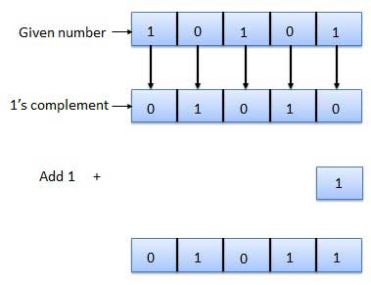
2’s complement 🡪

Slide 136
- (14) in 2’s complement form
Binary Number |  | 1 | 1 | 1 | 0
1’s Complement |  | 0 | 0 | 0 | 1
2’s Complement |  | 0 | 0 | 1 | 0
With Sign Bit | 1 | 0 | 0 | 1 | 0

Slide 137
+(12) in 2’s complement form
Binary Number |  | 1 | 1 | 0 | 0
1’s Complement |  | 0 | 0 | 1 | 1
2’s Complement |  | 0 | 1 | 0 | 0
With Sign Bit | 0 | 0 | 1 | 0 | 0

Slide 138
Addition-Subtraction of signed number using 2’s complement
Convert both numbers to equivalent binary form
Find the 2’s complement of subtrahend
Add this 2’s complement number to the minuend
If there is carry of 1, ignore it from the result to obtain the correct result.
If there is no carry, recomplement the result
attach the negative sign to the obtained result

Slide 139
Addition-Subtraction of signed number using 2’s complement
Add (27)10 and (-11)10 using complementary representation for the negative value.
27 = 011011 and 11 = 001011
2’s complement of (001011) = 1’s complement of (001011) + 1
= 110100 + 1
= 110101
Add (011011) and (110101)
1 1 1 1 1
0 1 1 0 1 1
+ 1 1 0 1 0 1
1 0 1 0 0 0 0
Carry Hence, result is (010000)2 or (16)10
1

Slide 140
Addition-Subtraction of signed number using 2’s complement
2. Subtract (25)10 from (42)10
25 = 011001 and 42 = 101010
2’s complement of (011001) = 1’s complement of (011001) + 1
= 100110 + 1
= 100111
Add (101010) and (100111)
1 1 1
1 0 1 0 1 0
+ 1 0 0 1 1 1
0 1 0 0 0 1
Carry Hence, Ignore carry and
result is (010001)2 or (17)10
1

Slide 141
Addition-Subtraction of signed number using 2’s complement
3. Subtract (14)10 from (46)10
14 = 00001110 and 46 = 00101110
2’s complement of (00001110) = 1’s complement of (00001110) + 1
= 11110001 + 1
= 11110010
Add (00101110) and (11110010)
1 1 1
0 0 1 0 1 1 1 0
+ 1 1 1 1 0 0 1 0
0 0 1 0 0 0 0 0
Carry Hence, Ignore carry and
result is (00100000)2 or (32)10
1

Slide 142
Addition-Subtraction of signed number using 2’s complement
4. Subtract 84 from 68 (68 – 84)
binary of 84 = 1010100
binary of 68 = 1000100
1’s complement of 84 = 0101011
2’s complement of 84 =
0 1 0 1 0 1 1
+ 1
0 1 0 1 1 0 0
Now, add 1000100 + 0101100 = 1110000
There is no carry, so we will take 2’s complement of result
Answer : - 0010000

Slide 143
Two's Complement Overflow Rules
The rules for detecting overflow in a two's complement sum are simple:
1. If the sum of two positive numbers yields a negative result, the sum has overflowed.
2. If the sum of two negative numbers yields a positive result, the sum has underflowed.

Slide 144
Overflow
Example: If we add two positive number 7 + 6 using 4-bit binary number, result should be +13
0111 (7)
+ 0110 (6)
1101
In signed notation, this is a result of -3, not +13
(because in 4 bit binary system, 4th bit represent sign bit and only 3 bits represent magnitude of the number.
Therefore, an overflow has occurred, where result would have
more bits than the original numbers.

Slide 145
Underflow
Example: If we add two negative numbers -29 and -13 using 8-bit binary number, result should be -42
29 = 00011101 13 = 00001101
1’s of 29 = 11100010 1’s of 13 = 11110010
2’s of 29 =11100011 2’s of 13 = 11110011
now, add 1 1 1 0 0 0 1 1
+ 1 1 1 1 0 0 1 1
1 1 1 0 1 0 1 1 0
Result is 11010110
In signed notation, this is a result of +214 and not of -42.
Therefore, an underflow has occurred.

Slide 146
Underflow
Example: If we add two negative numbers -3 and -3 using 3-bit binary number, result should be -6
3 = 011
1’s of 3 = 100
2’s of 3 =101
now, add 1 0 1
+ 1 0 1
1 0 1 0
Result is 010
In signed notation, this is a result of +2
(-6) = 1010 requires 4 bit.
Therefore, an underflow has occurred.

Slide 147
Cont…
Overflow in two's complement occurs, not when a bit is carried out of the left column, but when there is a carry into the sign.
A negative and positive added together cannot overflow, because the sum is between the addends.

Slide 148
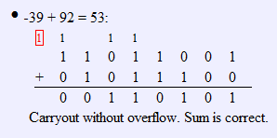
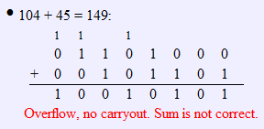
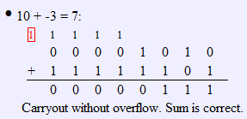

Slide 149
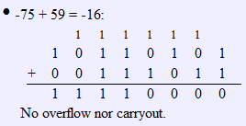
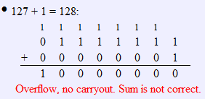
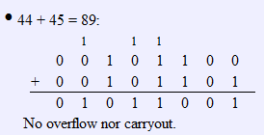
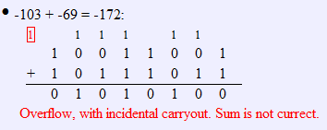
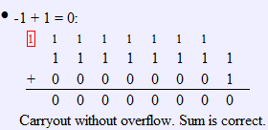
Examples

Slide 150
Basic Logic Gates

Slide 151
Logic gate is an elementary building block of a digital circuit.
Which when combined with each other are able to perform complex logical and arithmetic operations.
Two possible input
0 = 0v = False
1 = +5v = True

Slide 152
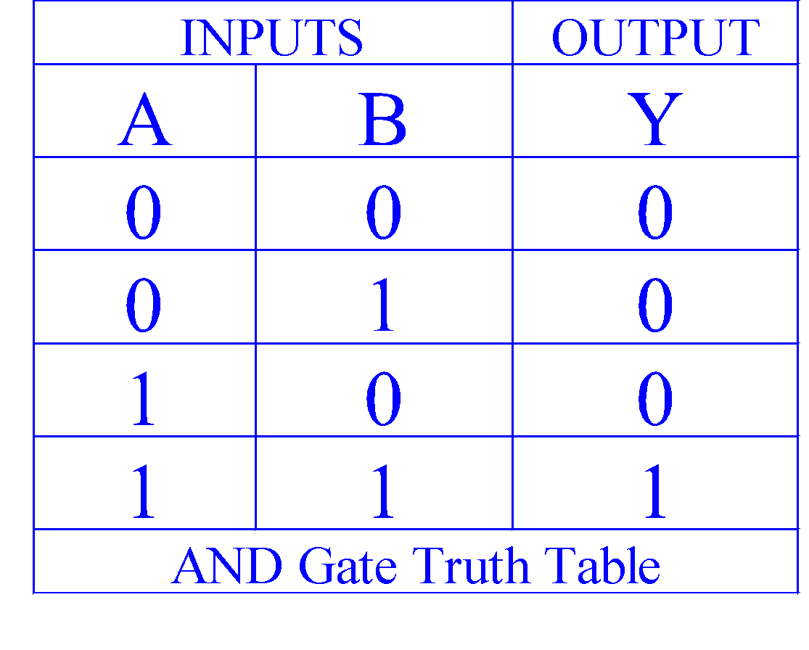

AND Function
Output Y is TRUE if inputs A AND B are TRUE, else it is FALSE.
Text Description ⇒
Logic Symbol ⇒
A
AND
Y
B
Truth Table ⇒
AND Symbol
Boolean Expression ⇒
Y = A x B = A • B = AB

Slide 153
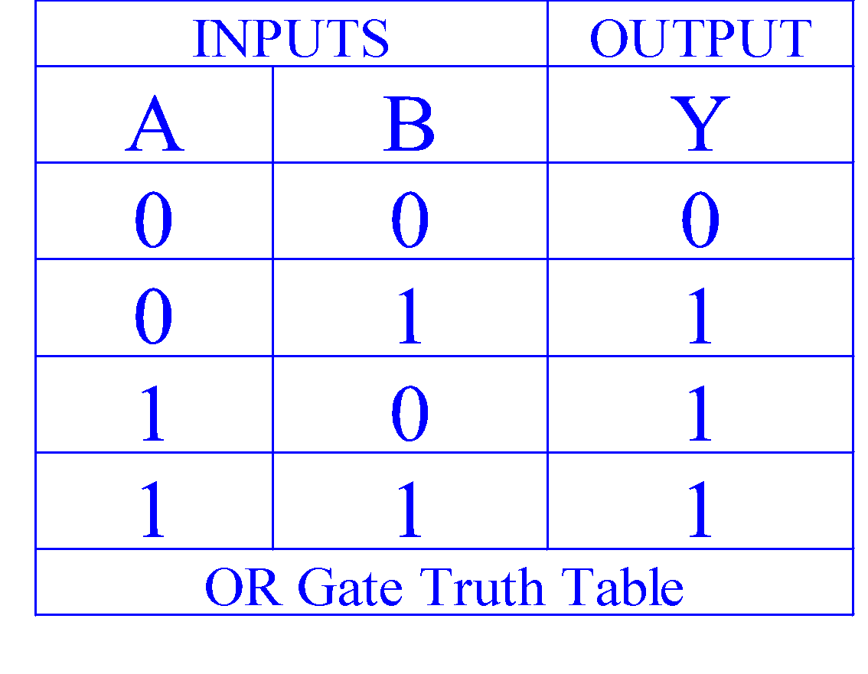
OR Function
Output Y is TRUE if input A OR B is TRUE, else it is FALSE.
Text Description ⇒
Logic Symbol ⇒
A
OR
Y
B
Truth Table ⇒
OR Symbol
Boolean Expression ⇒
Y = A + B

Slide 154
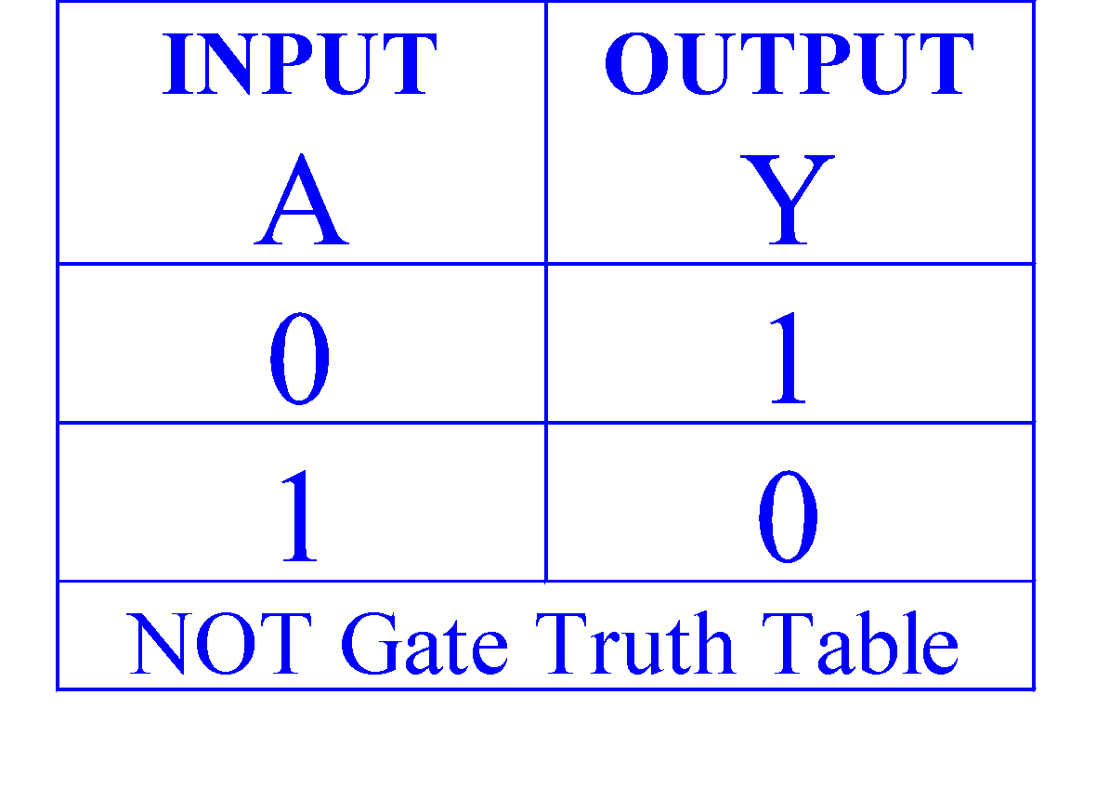
NOT Function (inverter)
Text Description ⇒
Output Y is TRUE if input A is FALSE, else it is FALSE. Y is the inverse of A.
Logic Symbol ⇒
A
NOT
Y
Truth Table ⇒
NOT Bar
Alternative Notation
Boolean Expression ⇒
Y = A’
Y = A
Y = !A

Slide 155
Combination of Logic Gates

Slide 156
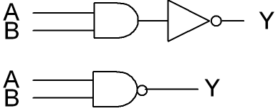
NAND Function
The term NAND is formed by the combination of NOT-AND
implies an AND function with an inverted output.

Slide 157
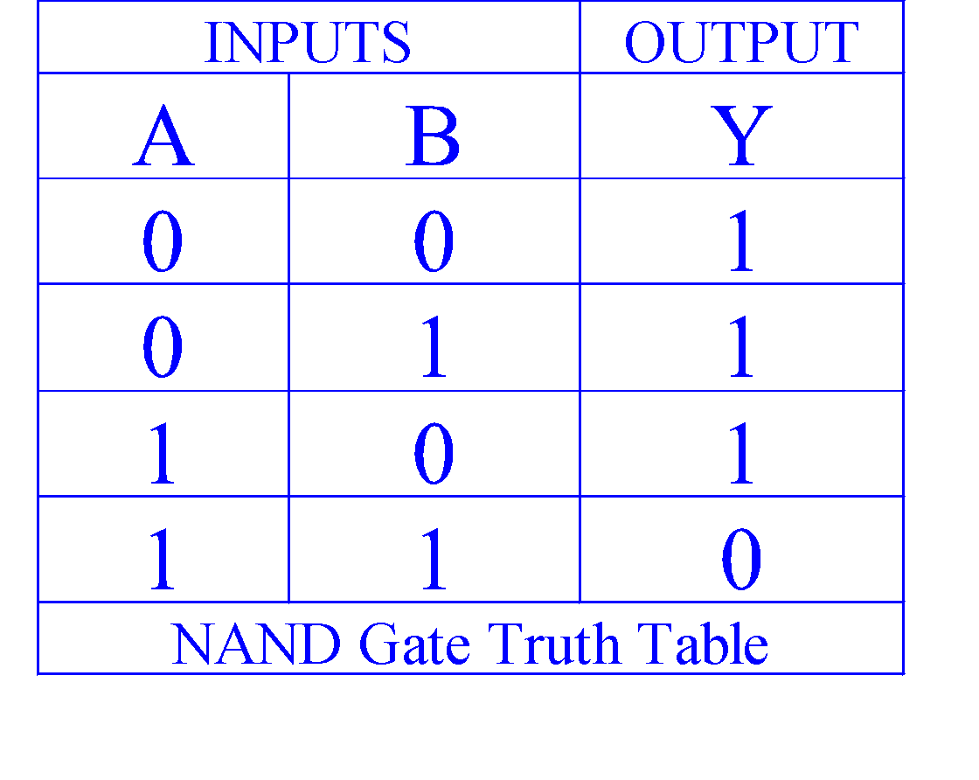
NAND Function
Output Y is FALSE if inputs A AND B are TRUE, else it is TRUE.
Text Description ⇒
A bubble is an inverter
This is an AND Gate with an inverted output
Logic Symbol ⇒
A
NAND
Y
B
Truth Table ⇒
Boolean Expression ⇒
Y = A x B = AB

Slide 158
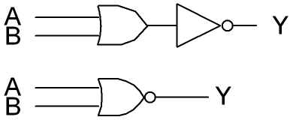
NOR Function
The term NOR is formed by the combination of NOT-OR
implies an OR function with an inverted output.

Slide 159
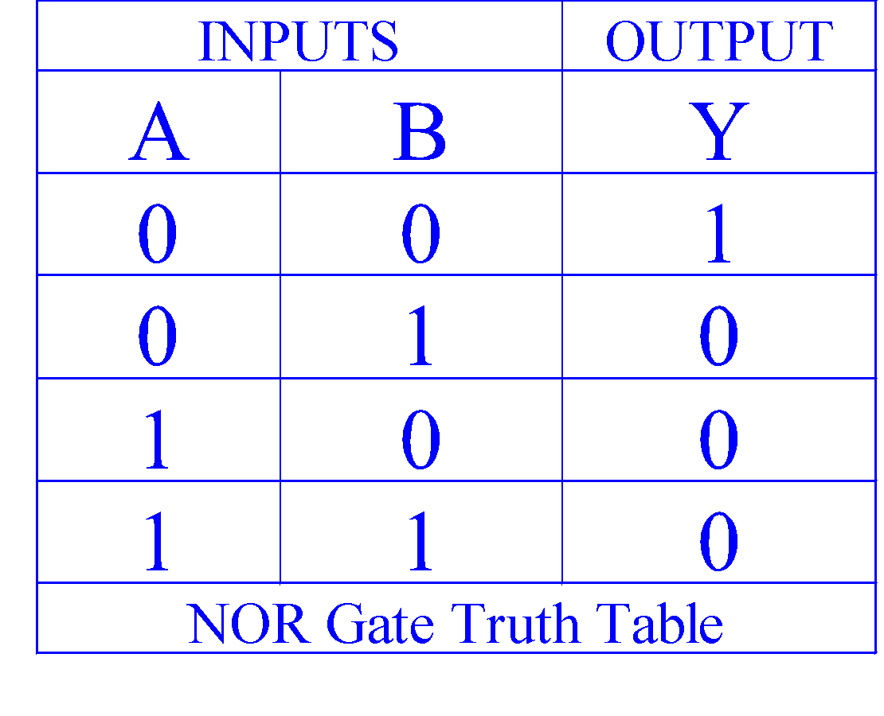
NOR Function
Output Y is FALSE if input A OR B is TRUE, else it is TRUE.
Text Description ⇒
A bubble is an inverter.
This is an OR Gate with its output inverted.
Logic Symbol ⇒
A
NOR
Y
B
Truth Table ⇒
Boolean Expression ⇒
Y = A + B

Slide 160
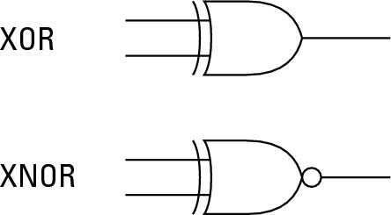
XOR and XNOR
XOR is an ‘inequality’ function 🡪 output is high(1) when the inputs are not equal to each other.
XNOR is an ‘equality’ function 🡪 output is high(1) when the inputs are equal to each other.

Slide 161
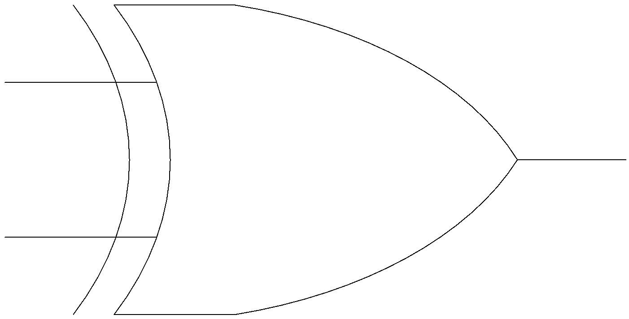
Exclusive-OR Gate
XOR
X Y Z
X
Z
0 0 0
Y
0 1 1
1 0 1
1 1 0
A B = A • B’ + A’ • B
+

Slide 162
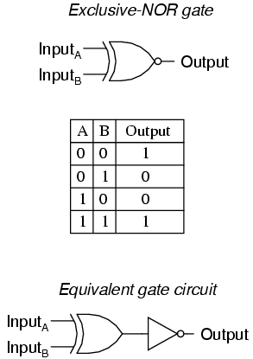
Exclusive-NOR Gate
A • B = A • B + A’ • B’

Slide 163
Boolean Algebra
Boolean algebra is the mathematics of digital systems.
It is extensively used in designing the circuitry that is used in computers.

Slide 164
Boolean Operations
The complement is denoted by a bar. It is defined by
0 = 1 and 1 = 0.
The Boolean sum, denoted by + or by OR, has the following values:
1 + 1 = 1, 1 + 0 = 1, 0 + 1 = 1, 0 + 0 = 0
The Boolean product, denoted by ⋅ or by AND, has the following values:
1 ⋅ 1 = 1, 1 ⋅ 0 = 0, 0 ⋅ 1 = 0, 0 ⋅ 0 = 0

Slide 165
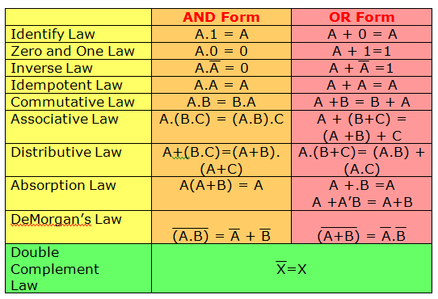
Laws of Boolean Algebra
A + AB =A

Slide 166


Laws of Boolean Algebra
Commutative Law
the order of literals does not matter
A + B = B + A
A B = B A

Slide 167
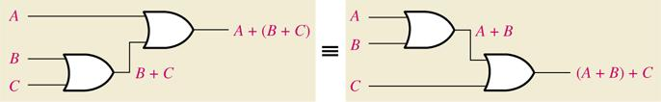
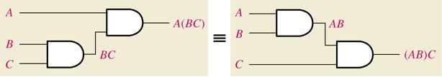
Laws of Boolean Algebra
Associative Law
the grouping of literals does not matter
A + (B + C) = (A + B) + C (=A+B+C)
A(BC) = (AB)C (=ABC)

Slide 168
Rules of Boolean Algebra
Rule Number | Boolean Expression
1 | A + 0 = A
2 | A + 1 = 1
3 | A • 0 = 0
4 | A • 1 = A
5 | A + A = A
6 | A + A’ = 1
7 | A • A = A
8 | A • A’ = 0
9 | A + AB = A
10 | A + A’B = A + B

Slide 169
Why codes are used?
Codes are used to represent the letters(A –Z, a-z) and special characters (such as +,-,*,$,&) in terms of 0’s and 1’s
Every character can be represented by a combination of bits that is different from any other combination.

Slide 170
Coding Systems
BCD - Binary Coded Decimal
ASCII - American Standard Code for Information Interchange
EBCDIC - Extended Binary Coded Decimal Interchange Code

Slide 171
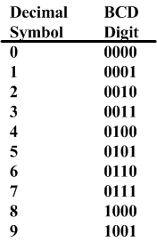
Decimal and BCD
The BCD is simply the 4 bit representation of the decimal digit.
For multiple digit base 10 numbers, each symbol is represented by its BCD digit
E.X.
5 3 1 9
0101 0011 0001 1001

Slide 172
BCD is fastest way to convert numbers from decimal to binary.
However, it can represent only 16,(2^4) symbols.
The later version of BCD used a 6-bit code, which allows representing a max. of 64 that is 2^6 symbols.
However, it is also not sufficient for modern computers.

Slide 173
ASCII
It stands for American Standard Code for Information Interchange
It is widely used in micro computers, data transmission.
Code was originally designed as 7 bit code
Later on, IBM developed a new version of ASCII called as ASCII-8.
They use of all 8 bits providing 256 symbols

Slide 174
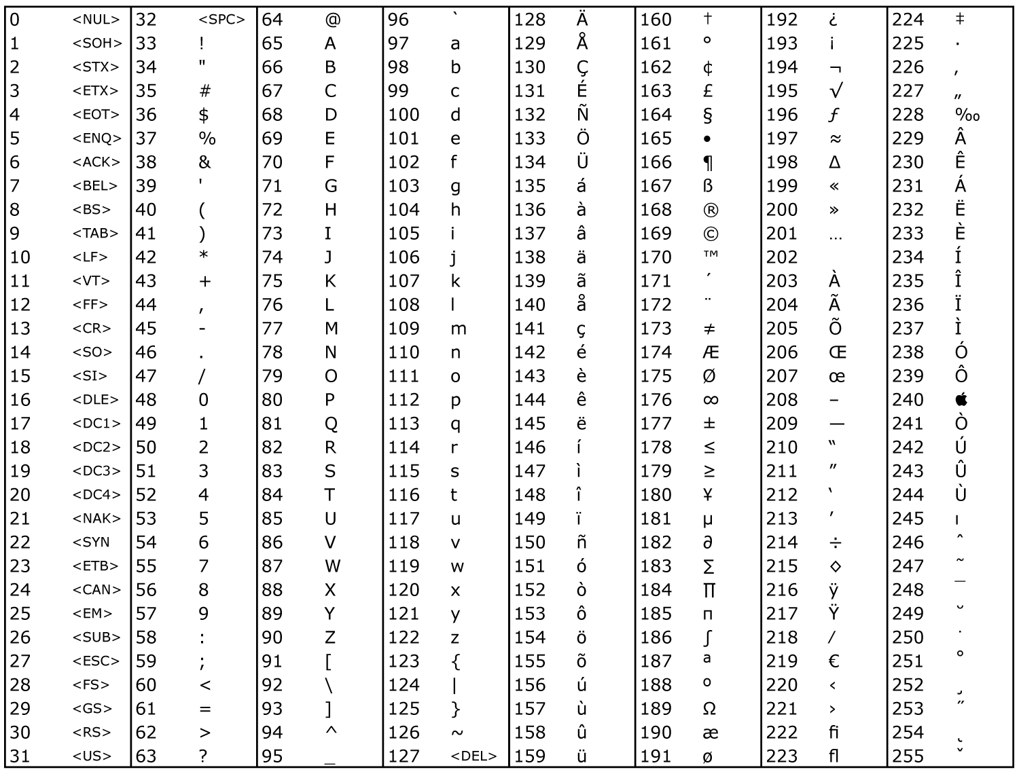
ASCII

Slide 175
Determine the binary code of ‘word’ in the ASCII form.
w o r d
119 111 114 100
01110111 01101111 01110010 01100110

Slide 176
EBCDIC
Extended Binary Coded Decimal Interchange Code uses 8 bits for each character.
Provides 256 different unique code
Character | Zone bits
A – I | 1100
J – R | 1101
S – Z | 1110
0 - 9 | 1111
a – i | 1000
j – r | 1001
s – z | 1010

Slide 177
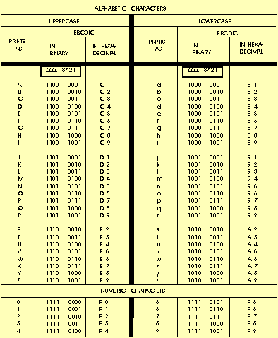
EBCDIC

Slide 178
EBCDIC vs. ASCII
Character | D | P | 3
EBCDIC | 1100 0100 | 1101 0111 | 1111 0011
ASCII | 0100 0100 | 0101 0000 | 0011 0011

